Slide 1
Lab 9: Inference for Population Mean
STAT 201: Elementary Statistics
Imtiaz Ebna Mannan

Slide 2
Introduction
Data from the class (a sample) will measure the short term effect of a particular exercise on the human cardiovascular or pulmonary system.
We will use the sample data to make statistical inferences to draw conclusions about the effect of the treatment on the population represented by the sample taken.
This lab will look at the short-term effects of climbing stairs on the way to class.

Slide 3
Setting
For 20 year olds to achieve beneficial cardiovascular effects, an activity should raise their heart rate above 120 and below 170 beats per minute.
Study – we want to determine the benefits of taking the steps on the way to class.
This class will act as a sample to:
formally estimate the population mean heart rate increase after taking the stairs.
formally test whether this exercise raises heart rate above 120 bpm on average.

Slide 4
Note
Your participation in walking stairs is completely voluntary. You may decline if you are uncomfortable with any part of the exercise. If you do participate, take care when walking stairs; always walk at a safe pace.

Slide 5
Calculate Resting Heart Rate
While sitting, find your pulse (on wrist or on throat).
When I say go start counting the number of beats, we will use a 15 second time interval.
We can do multiple times if someone lost their pulse.
Enter your resting heart rate in table 9.1 on page 69.
And on paper provided.

Slide 6
Heart Rate After Climbing Stairs
Take whatever you brought with you to class (bookbag, purse, etc.).
(For students in COL 2005) Take the stairs down to 115 that’s outside your room and come back up. Do this whole routine twice. Get back and be seated in your seats in the classroom.
(For students in COL 4037) Take the stairs up to the second floor and then come back down. Do this whole routine twice. Get back and be seated in your seats in the classroom.
BE CAREFUL and Be QUIET.
After everyone is back. Find your heartbeat and I will tell you when to start counting (15 seconds).
Put your heart rate after climbing stairs in table 9.1 page 69.
And on Paper Provided

Slide 7
After Returning to the Classroom
Complete table 9.1 and paper provided.
Turn in paper to instructor in order to compile data for the entire class.
Or the instructors can ask them out loud and the individual data can be compiled into a spreadsheet in front of the whole class.

Slide 8
Group Data
Student | HRA60 Heart Rate After Stairs | HRI Heart Rate Increase
1 | 92 | 12
2 | 120 | 20
3 | 80 | 28
4 | 68 | 8
5 | 156 | 16
6 | 124 | 4
7 | 116 | 20
8 | 88 | 12
9 | 108 | 36
10 | 64 | -12
Student | HRA60 Heart Rate After Stairs | HRI Heart Rate Increase
11 | 92 | 24
12 | 120 | 16
13 | 84 | 4
14 | 76 | 0
15 | 92 | 12
16 | 68 | -28
17 | 80 | 12
18
19
20

Slide 9
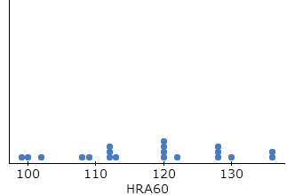
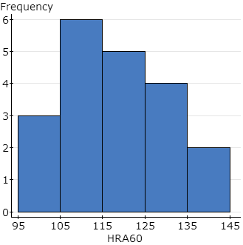
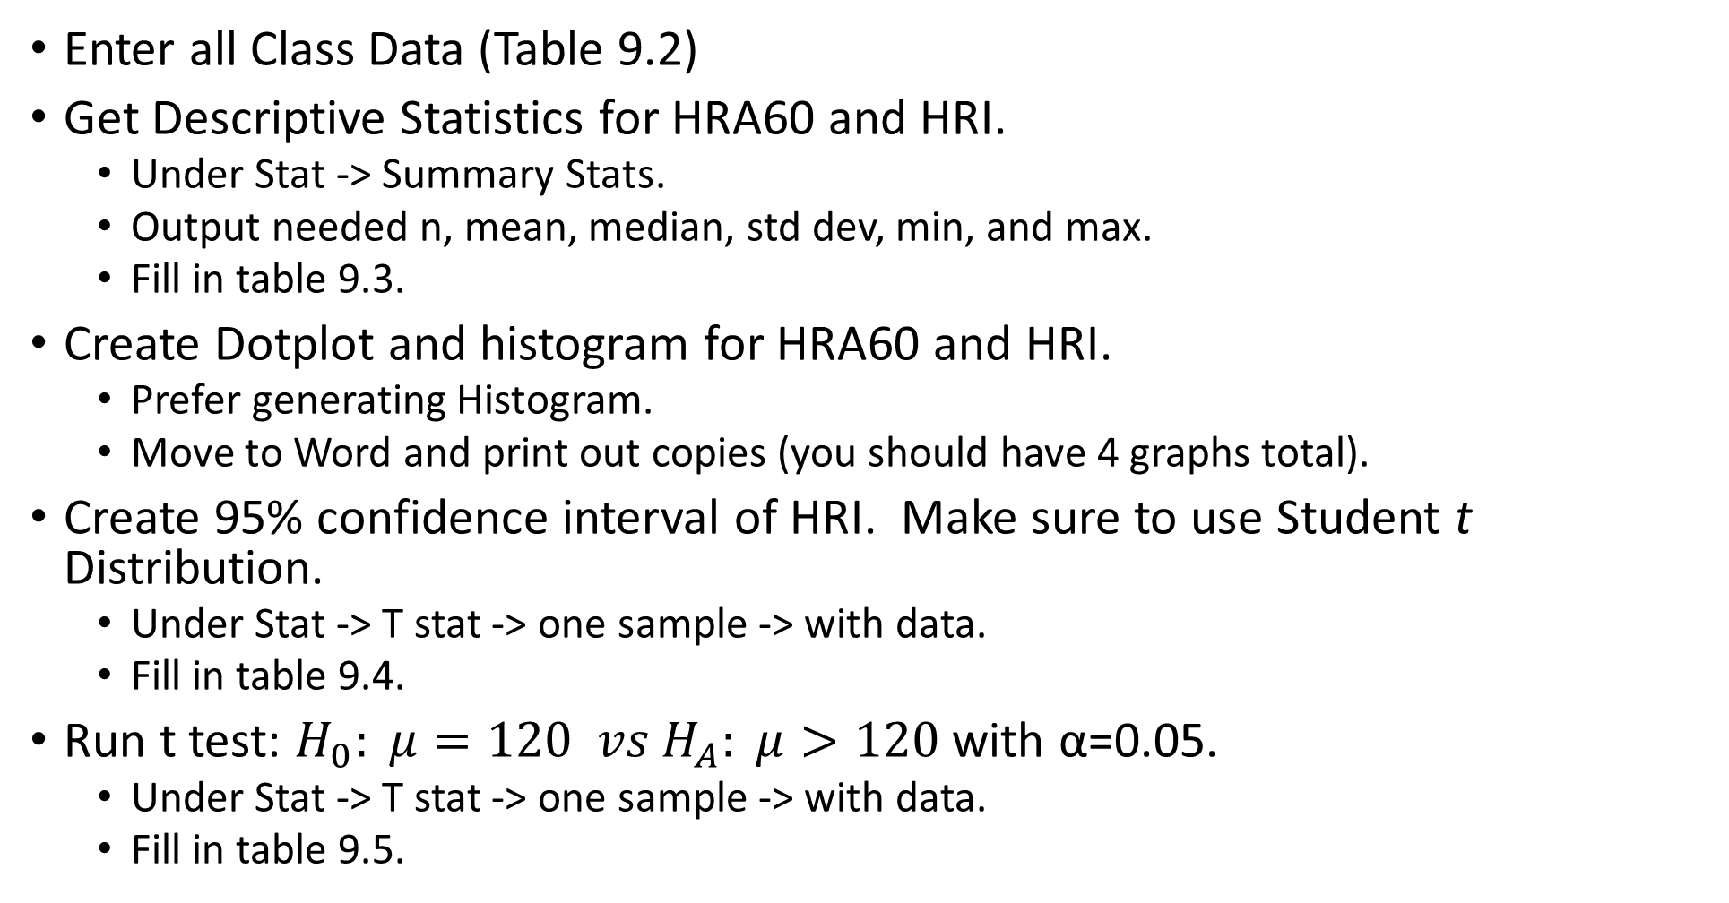
Data Analysis (In StatCrunch)
Enter all Class Data (Table 9.2)
Get Descriptive Statistics for HRA60 and HRI.
Under Stat -> Summary Stats.
Output needed n, mean, median, std dev, min, and max.
Fill in table 9.3.
Create Dotplot and histogram for HRA60 and HRI.
Prefer generating Histogram.
Move to Word and print out copies (you should have 4 graphs total).
Create 95% confidence interval of HRI. Make sure to use Student t Distribution.
Under Stat -> T stat -> one sample -> with data.
Fill in table 9.4.
Run t test: $H_{0}: μ=120 vs H_{A}: μ>120$ with α=0.05.
Under Stat -> T stat -> one sample -> with data.
Fill in table 9.5.

Slide 10
Discussion Questions
Questions 1 and 2: You may use the histogram instead of dotplot if it gives a better picture of the shape.
Question 3: Make sure your interpretations are similar to the ones we have used in class. For concerns remember the assumptions:
Data was obtained using randomization.
Data was from an approximately normal distribution.
Question 4: Make sure you show all steps for the hypothesis test but you may use output from StatCrunch instead of doing calculations by hand.
Check assumptions – variable quantitative, randomization, approx. normal
State hypotheses.
Give test statistic.
Determine p-value.
Conclusion – decision and interpretation.

